Slide 1
Evaluating Route Combinations with Association Rules
Scott Fields
Scott.H.Fields1@gmail.com
July 2021

Slide 2
Premise and Assumptions
When tasked with finding the most popular route combinations in the NFL, I decided to place the main focus on combination rather than popular
If you simply look at most popular route combos, you will see mostly curl routes which makes sense because curls are the most common route
But that’s not very interesting, I wanted to find route combinations that were called because they work well together and create an advantage for the offense
Association Rules analyze combinations of events and find the combinations that occur more often than expected
I also decided to only analyze passing plays under the assumption that EPA from rushing plays was simply noise when considering route effectiveness

Slide 3
Association Rules – An Example
Running Back running a route to the flat on the right side
30% of all plays with “TE - R - Corner” also had a “RB - R - Flat” route
TE
RB
First Route | Second Route | Support | Confidence | Lift | Count
TE - R - Corner | RB - R - Flat | .0061 | .3022 | 4.108 | 126
Tight End running a corner route on the right side
0.61% of all plays in the data set had both of these routes
“RB - R - Flat” occurs 4x more when paired with “TE - R - Corner” than in the rest of the data set.
These routes are clearly working together

Slide 4
Association Rules
First Route(s) | Second route | Support | Confidence | Lift | Count
SWR - L - Slant / WR - R - Slant | WR - L - Slant | 0.005 | 0.75 | 12.44 | 98
SWR - R - Slant | WR - R - Slant | 0.013 | 0.30 | 6.03 | 247
SWR - R - Seam / WR - L - Curl | WR - R - Curl | 0.006 | 0.64 | 5.17 | 114
WR - R - Slant | WR - L - Slant | 0.014 | 0.28 | 4.59 | 258
TE - R - Corner | B - NULL - Flat - Right | 0.007 | 0.30 | 4.11 | 126
SWR - L - Curl / WR - L - Curl | WR - R - Curl | 0.011 | 0.41 | 3.34 | 198
WR - L - Curl | WR - R - Curl | 0.044 | 0.36 | 2.93 | 818
WR - L - Go/Fly | WR - R - Go/Fly | 0.026 | 0.25 | 2.60 | 484
SWR - R - Fade | WR - R - Curl | 0.010 | 0.31 | 2.53 | 182
TE - R - Flat - Right | SWR - R - Curl | 0.008 | 0.32 | 2.41 | 156
SWR - R - Over Ball | WR - R - Curl | 0.007 | 0.30 | 2.39 | 126
SWR - R - Curl / WR - R - Curl | SWR - L - Curl | 0.008 | 0.29 | 2.37 | 148
SWR - L - Flat - Left | SWR - L - Curl | 0.009 | 0.28 | 2.24 | 165
SWR - R - Curl | SWR - L - Curl | 0.034 | 0.25 | 2.04 | 628
SWR - R - Seam | WR - R - Curl | 0.015 | 0.25 | 2.03 | 269
I implemented a minimum Support of 0.005 and a minimum Confidence of .25 to strike a balance between popularity and uniqueness
This resulted in 15* combinations, all with a Lift of more than 2
Now we can analyze how these combinations perform against popular coverage schemes.
*34 combinations met the criteria but many of them were repeats of others with the first and second routes switched, or the same routes flipped to the other side of the field, for this research I am assuming routes flipped are the same and combine them for the rest of the analysis

Slide 5
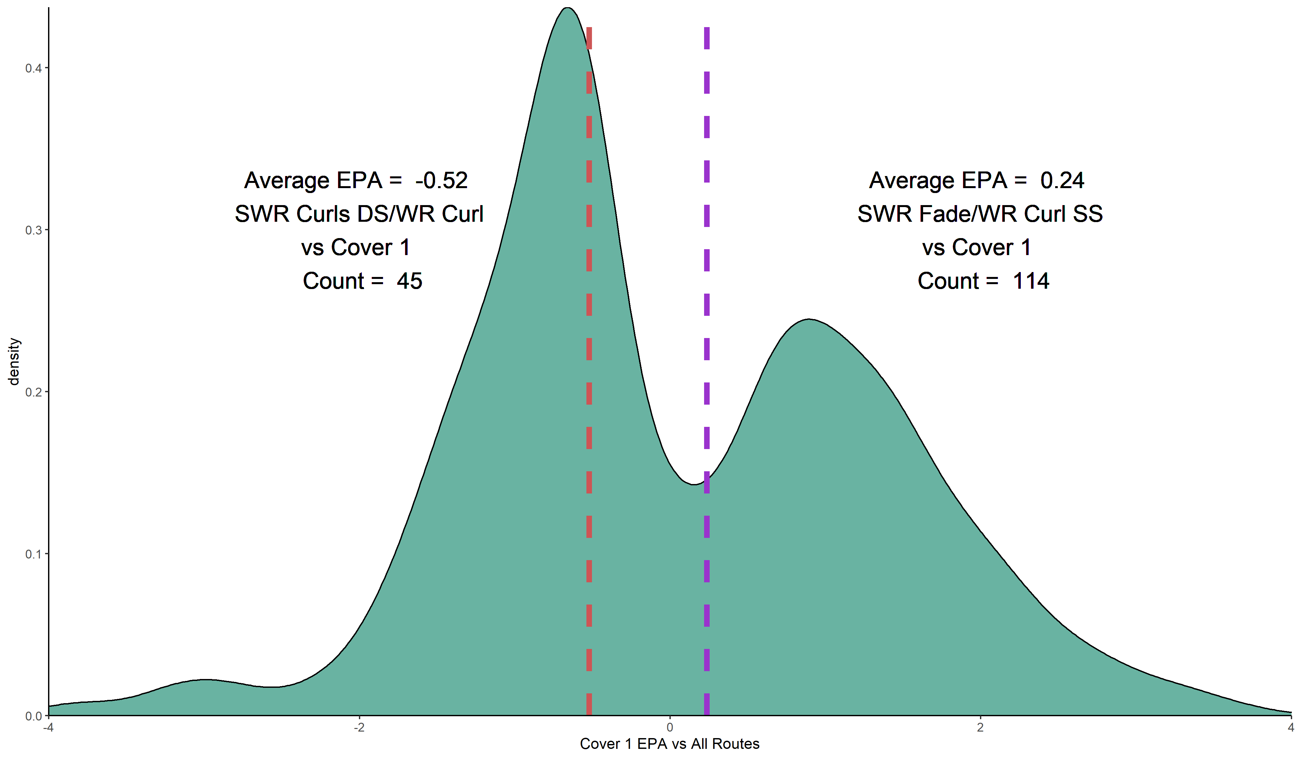
Findings – Cover 1
The Best performer against Cover 1 is a fade route from the slot going over a curl on the outside
This makes a lot of sense considering the lone high safety will have a hard time getting over to a fade route
Three curl routes was the worst performer, failing to capitalize on the open space on the sidelines up the field
All plays with two Slot Receivers running curl routes on opposite sides and a WR running a curl as well vs Cover 1
All plays with a WR running a curl route and a Slot Receiver running a fade on the same side of the field vs Cover 1
SS = Same Side
DS = Different Side

Slide 6
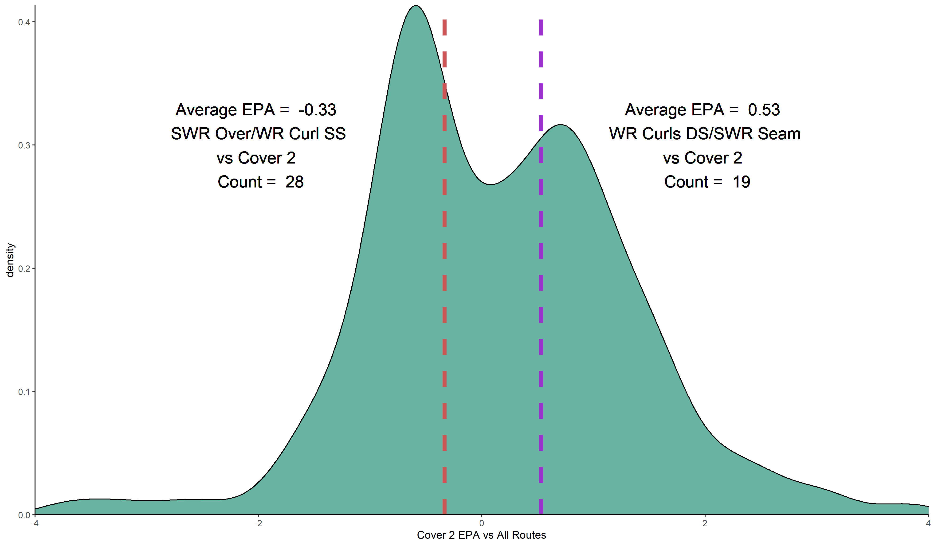
Findings – Cover 2
Cover 2 gets beat by curls on the outside and a seam from the slot
With all three routes starting vertical, neither safety can commit to the slot receiver and the middle of the field is open for the seam route
The worst combination comes from an over ball route and curl from the same side, showing essentially 2 curls struggling against cover 2 as well

Slide 7

Findings – Cover 2 - Man
Two slants from the same side are able to thrive against man coverage with no zone help over the middle
The quarterback can look to one side of the field for a quick throw and only needs one of his receivers to beat their man
Opposite side curls does not fare well against Cover 2 – Man with corners able to press as the safeties watch over top

Slide 8
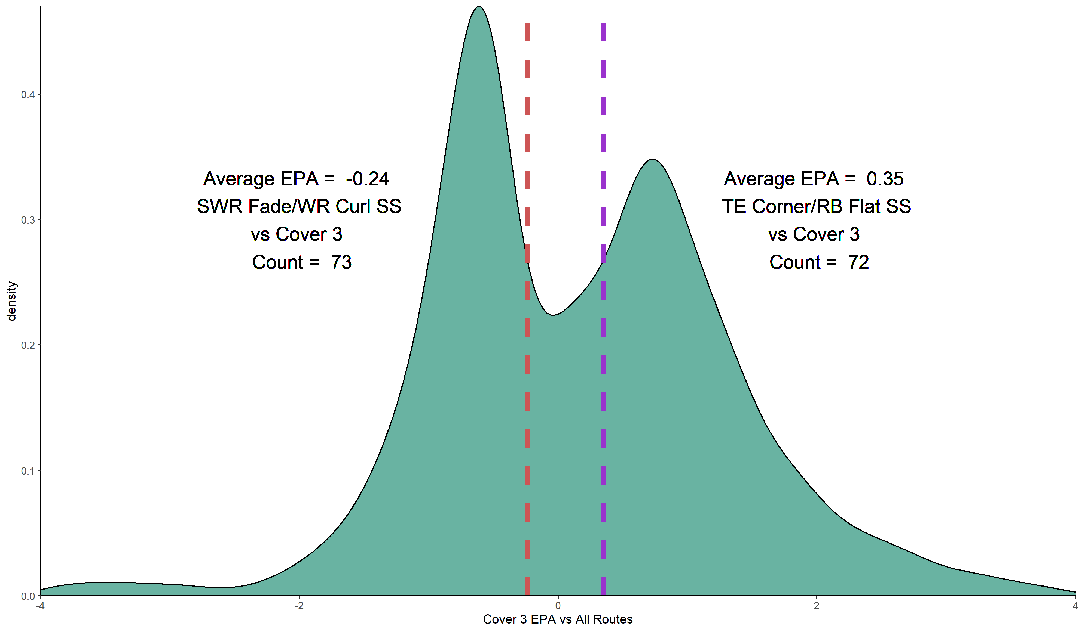
Findings – Cover 3
The TE Corner and RB Flat combination are able to exploit Cover 3
With 3 men deep the defense may only have one man guarding the shallow sideline and he has to pick between the TE or RB, leaving one open
Two outside curls with a slot fade does not work well against Cover 3 with safeties guarding both deep sidelines

Slide 9
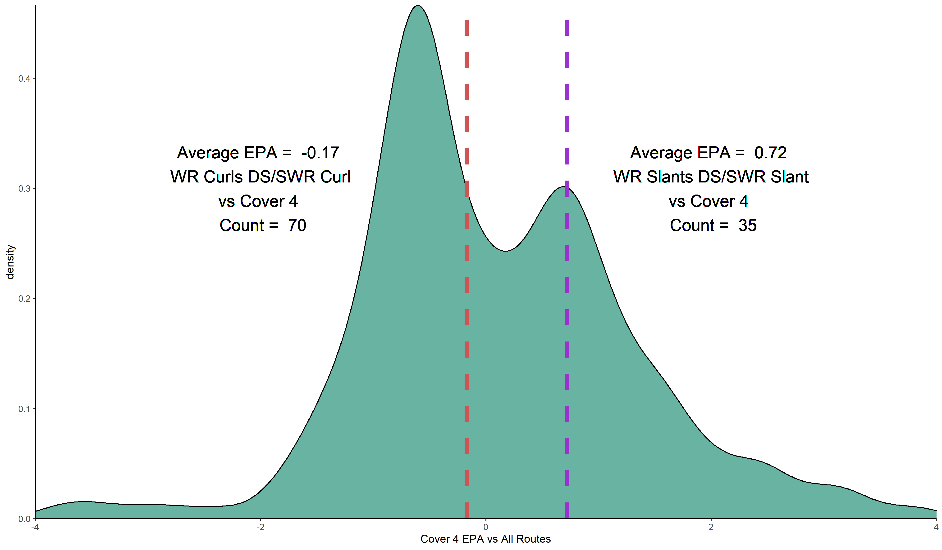
Findings – Cover 4
Three slants against cover 4 is a mismatch for the offense, with so many men deep, its easy to complete the short quick pass and get the receiver into open space
Three curls is once again the worst performer, not being able to take advantage of the gaps left by the zone coverage

Slide 10
Conclusion
All but one of the routes in the worst performing combinations were curls
While curls can be useful in creating space for other routes, it seems as if they are over utilized compared to other routes that can get players moving into space
Using Association Rules helps us find combinations of routes that are actually working together to attack the defense, and if an Offensive Coordinator has a good idea of what defense is coming, can use these rules and this type of analysis to find the best way to attck

Slide 11
Limitations and Future Analysis
The biggest limitation is the amount of data, with more seasons the rules would be more robust and could be better compared to the coverages
One interesting potential piece of research would be to make a model of how similar different routes are and then use that to predict route combinations that would work best against different coverages
Association Rules could be used on individual teams by defenses to see what combinations certain coaches like to run more than others

